Slide 1
Online Retailer Performance Analysis
Analysis of Online Retail Tracking Data from July 2012 through June 2013
Yosef Borsykowsky

Slide 2
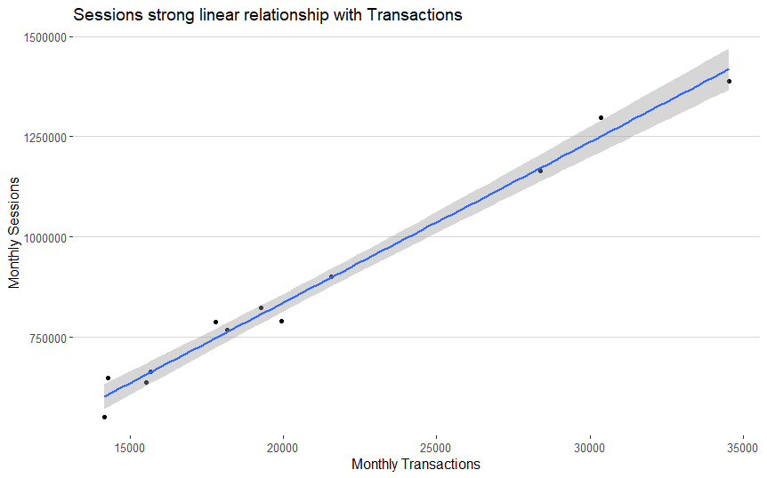
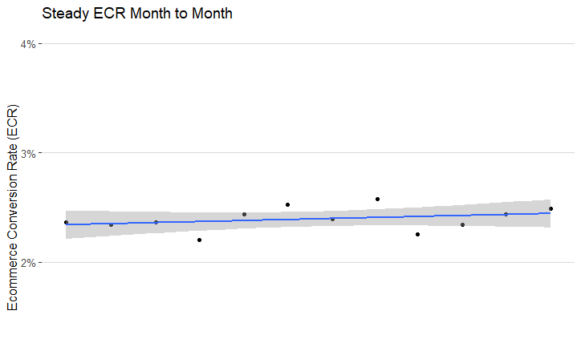
Sessions equal Transactions
Sessions have a 98% correlation with transactions
Last month a 19% increase in sessions led to a 22% increase in transactions
Flat ECR indicates sessions consistently lead to transactions

Slide 3
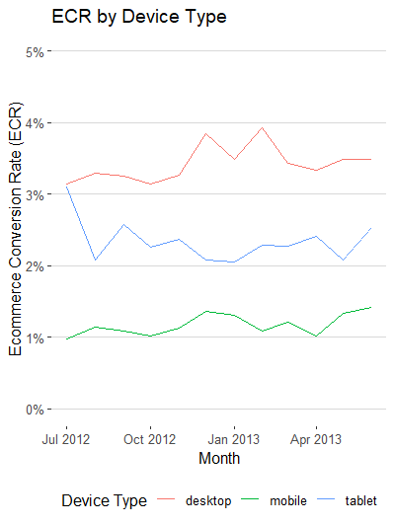
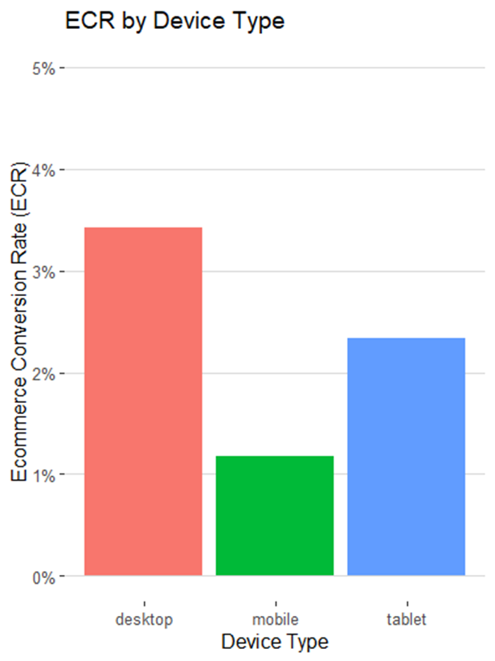
Ecommerce Conversion Rate (ECR) vary by device
Desktops (3.4%) significantly outperformed tablets (2.3%) and mobile devices (1.2%) in ECR
Desktop devices accounted for only 43% of sessions but over 60% of transactions

Slide 4
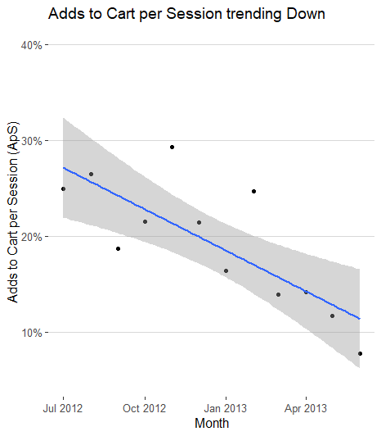
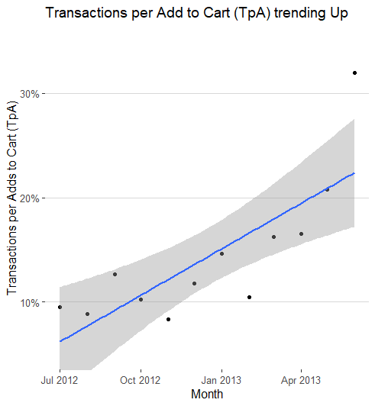
Adds to Cart per Session have decreased, but have become more effective at driving Transactions

Slide 5
Next Steps:
Investigate why Adds to Cart per session (ApS) trended down
Work to increase ECR for mobile devices (Ease of Purchase?)
Increase ad share for Desktop devices to drive Transactions

